Slide 1

Dosing Accuracy&Stability Tool Introduction
PPE Course 2015, Ambuja Nagar, Sven Ritschard - Geocycle
© 2015 Holcim Technology Ltd

Slide 2
Timing:
20 min: Introduction Dosing Accuracy & Stability Tool
10 min: Case Study Introduction
45 min: Solve Case Study
15 min: Discussion of Solutions

Slide 3
Objectives
Understand dosing accuracy and stability
Being able to assess a feeding system (dosing) performance in a standardized way by using the tool
Judge the dosing accuracy and stability
Ultimate Objectives as PPE:
Use the tool!
Identify potential/weakness of the AFR feeding system
Improve dosing systems!!!

Slide 4
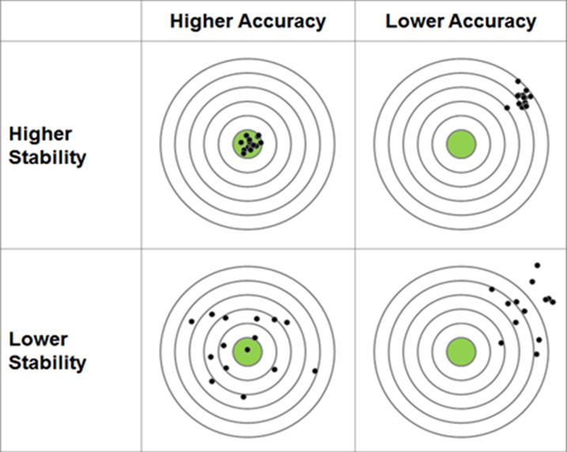
What is dosing accuracy and stability?
High accuracy: present value (PV) average ≈ set-point (SP)
High stability: small deviation between PV and SP over time
What is more important? Accuracy or stability?

Slide 5
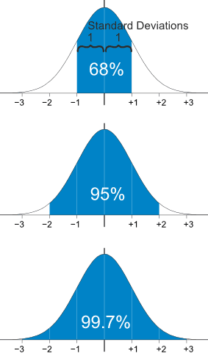
Standard Deviation shows how much variation from Mean. Coefficient of Variation makes deviation comparable.
68% of values are within 1 standard deviation (±1 σ) of the mean. In other words, 680 values out of 1000 are likely to be within 1 standard deviation.
Coefficient of Variation (CV) defined as the ratio of the standard deviation to the mean.
As CV is unitless it allows comparing the degree of variation from one data series to another, even if the means are drastically different from each other.
CV | Coefficient of Variation
σ | Standard Deviation
 | Sample Mean

Slide 6
Tolerated deviation from target and desired Confidence Interval define maximum CV (limit).
CV may also be expressed as ratio of Percentage Deviation from Population Mean to the Standard Deviation.
Example: 90% of the values should be within ± 2.0% of the target (average). 90% relates to the confidence interval.
Δμ = 2%
zσ = 1.645
→ CV = ± 2% / 1.645 = ± 1.22% ...if the CV of the dataset is < 1.22%, then 90% of the values deviate less than 2% from the average.

Slide 7
Accuracy test
3 Tests: Average weight difference (control scale vs. dosing equipment) should be < 0.5%.
Complementary information:
Material
Measurement unit
Dosing equipment
Test target feed rates

Slide 8

Stability test
Choose material category:
Consider guide values for test duration and data frequency.
Define feed rate set-point (keep constant) for three tests:
Enter process values:

Slide 9
Evaluation / Summary

Slide 10
Evaluation / Summary

Slide 11
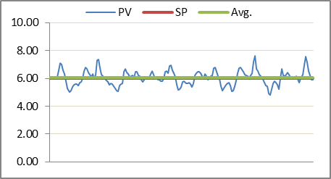
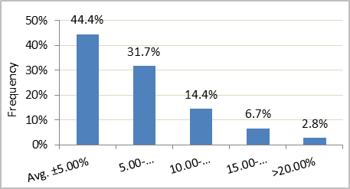
Evaluation / Summary

Slide 12
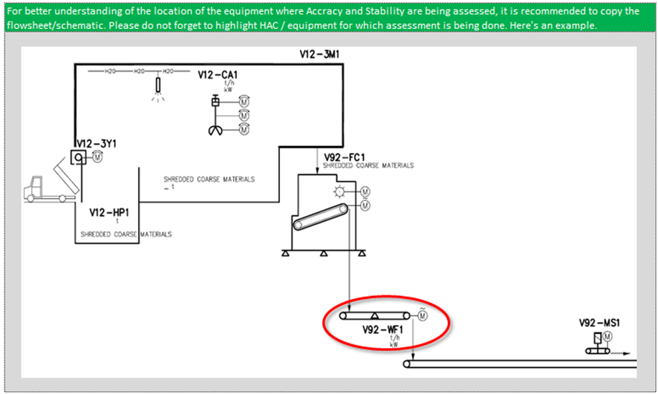
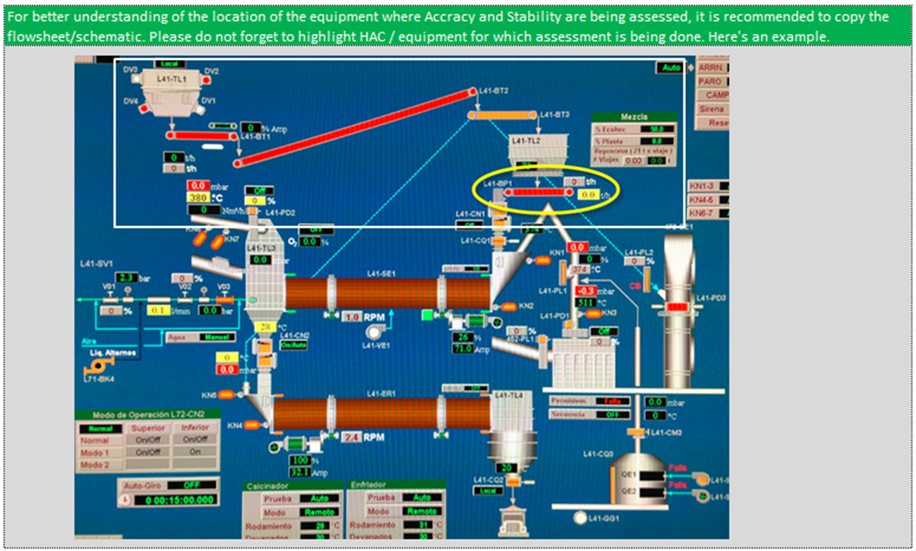
Insert flowsheet in the tool and highlight dosing equipment

Slide 13
Procedure to evaluate a feed system with the tool
Data extraction, evaluation and selection
Enter the appropriate data
Evaluate the dosing accuracy and stability
Include flowsheet

Slide 14
Let’s check the solid AF dosing stability in Ramos Arizpe Guess the feeding stability?
Data extraction and selection
How much/long data?
What data frequency (hour, minute, second)?
Average or spot data?
Make a graph!
Data evaluation
Is the data plausible (e.g. no filter already applied / rounded data)?
Is the data suitable (e.g. no feed starvation or set-point changes)?
Are there regular/periodic dosing fluctuations?
With longer data set:
Frequent feed rate changes?
Frequent stops of the feed system?
Select required data set by the tool:
E.g. Minute averages for 3 hours for coarse solid AF → 180 values

Slide 15
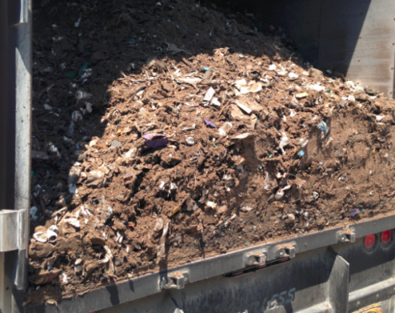
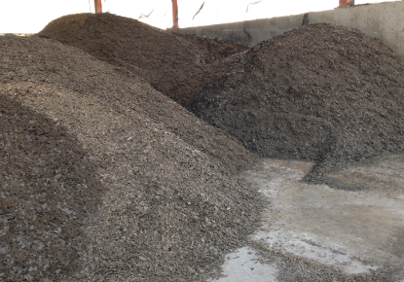
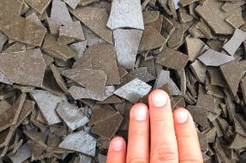
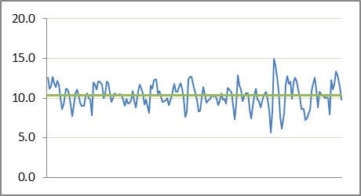
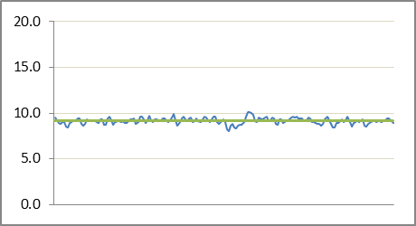
Example: Different AF material types can influence the dosing performance
Feed rates (t/h) during 3h: mixed AF material and nylon recycling residue

Slide 16
What to do if the results are out of acceptable range?
Is the feeder properly calibrated?
Is the existing feeder compatible with the material (particle size, bulk density, moisture content)?
Is the feeder run in automatic (control loop) or manual mode?
Is the feed controller (PID) well adjusted?
Is any extensive wear visible at/inside the feeder?
Are there extraction problems from the hopper prior to the dosing equipment?
Is the pre-dosing working properly (e.g. material bed height on transport prior to weigh feeder)?
Is the house keeping done properly in the area of the feeder (e.g. dust layers on top)?

Slide 17
Final thoughts
What you do not measure/analyze you cannot judge.
Without assessment you cannot improve.
You need to spend time to assess and understand your feed system and its behavior.
How is the dosing accuracy / stability and is it consistent?
Do I have adequate and sufficient sensors for feed rate control?
Do kiln operators have enough information? Cameras!
Is the control loop well tuned?
What material properties cause issues? → feedback Geocycle
How can you improve the system (with or without CAPEX)?

